Slide 1

TEEGALA KRISHNA REDDY ENGINEERING COLLEGE
(Approved By AICTE , Affiliated To JNTUH, Accredited By NBA And NAAC)
Department of Computer Science & Engineering
HEAD OF THE DEPARTMENT Dr. CH. V. PHANI KRISHNA
Professor
PROJECT CO-ORDINATOR Mrs. A.MOUNIKA
Assistant Professor

Slide 2
Farmer LinkedIn (Smart Agri Workforce Platform)
SUPERVISOR
Mrs.A.Mounika
Assistant professor
NAME OF THE STUDENTS
D.Chaitanya Varma
G.Harinadh Babu
(23R91A0569)
(23R91A05A7)
I.Rishi Adwith Swastik (23R91A05B8)

Slide 3
CONTENTS
ABSTRACT
INTRODUCTION
EXISTING SYSTEM
PROPOSED SYSTEM
SYSTEM ARCHITECTURE
UML DIAGRAMS
SYSTEM SPECIFICATIONS
MODULES
OUTPUT SCREENS
CONCLUSION
REFERENCES

Slide 4
ABSTRACT
This project proposes a smart digital platform that connects farmers, agricultural workers, and landowners on a single network, similar to a professional linking system for agriculture. The system provides AI-based worker recommendations using location, skills, availability, ratings, and cost. A wage prediction module helps ensure fair pricing for both farmers and workers. Crop and season-based labor planning simplifies workforce estimation. Voice-based interaction with Telugu support improves accessibility for rural users. Additional features such as worker availability calendars, emergency labour requests, land-sharing options, and weather alerts enhance decision-making. The platform aims to improve efficiency, transparency, and trust in agricultural labour and land management.

Slide 5
INTRODUCTION
Agriculture is still the driving force behind the Indian economy, but farmers still have issues with accessing reliable labour, determining a fair wage rate, and effectively utilizing land resources. Most of the current agricultural applications available are related to advisory, equipment rental, or market prices, but labour management is still done manually by networking with people. This results in time wastage, disputes over wages, and unavailability of labour during peak agricultural seasons. With the rise of smartphone usage in rural areas, there is a great need for a platform that brings farmers, agricultural labour, and landowners together in an organized and trustworthy manner. This proposal brings forth a smart-agri workforce application that utilizes AI recommendations, voice interaction, and availability tracking to make labour and land sharing easier.

Slide 6
EXISTING SYSTEM
In the existing system, agricultural labor management is mostly carried out through manual methods such as personal contacts, local labor contractors, and word-of-mouth communication. While several agricultural mobile applications are available, they primarily focus on advisory services, farm machinery rental, and market price information rather than labor hiring and land management. Applications like FARMS – Farm Machinery Solutions, Kisan Sarathi, Farmitra, and KhetEase support farmers with guidance and information but do not provide a structured digital system for workforce availability, wage transparency, or land-sharing. As a result, farmers face operational inefficiencies, especially during peak agricultural seasons.
Drawback or Limitations
Finding workers takes more time
No clear idea of worker availability
Wage rates are not transparent
Frequent misunderstanding and disputes
Not useful during urgent labour needs

Slide 7
PROPOSED SYSTEM
The proposed system is a smart digital platform that connects farmers, agricultural workers, and landowners through a single application. It uses AI- based recommendations to suggest suitable workers based on location, skills, availability, and ratings. The system also provides wage estimation, voice-based interaction, and real-time worker availability tracking. Additional features such as emergency labour requests, land-sharing options, and weather alerts help farmers make better decisions. Overall, the platform simplifies labour hiring and land management while improving transparency and efficiency.
Advantages of Proposed System
Easy and quick worker selection
Fair and transparent wage estimation
Voice support for rural users
Real-time worker availability tracking
Emergency labour support
Better use of land resources

Slide 8
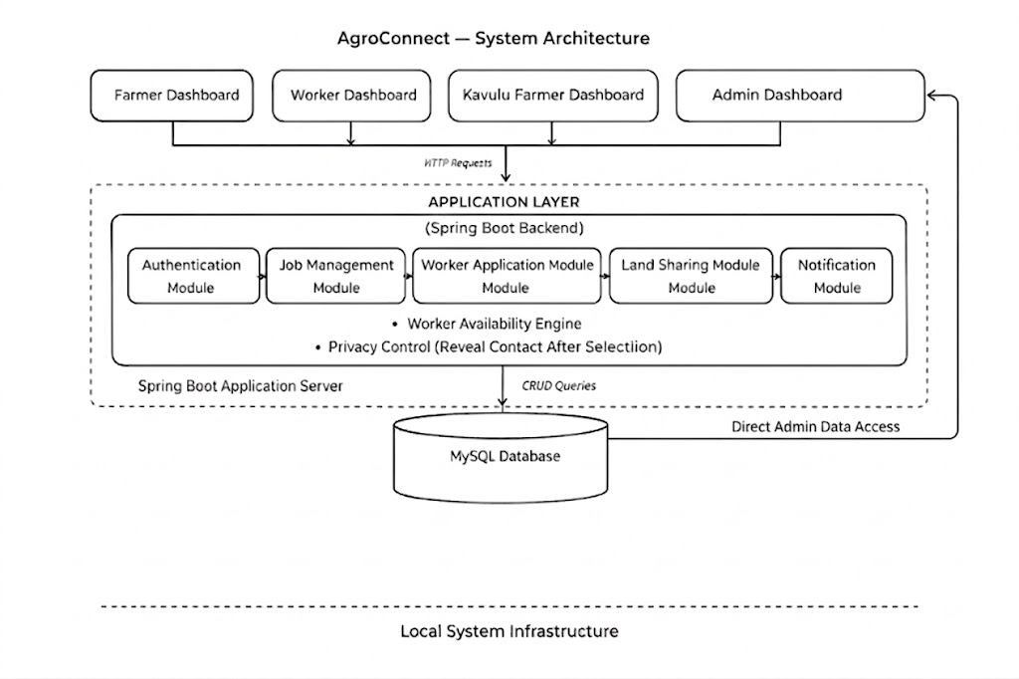
System Architecture

Slide 9
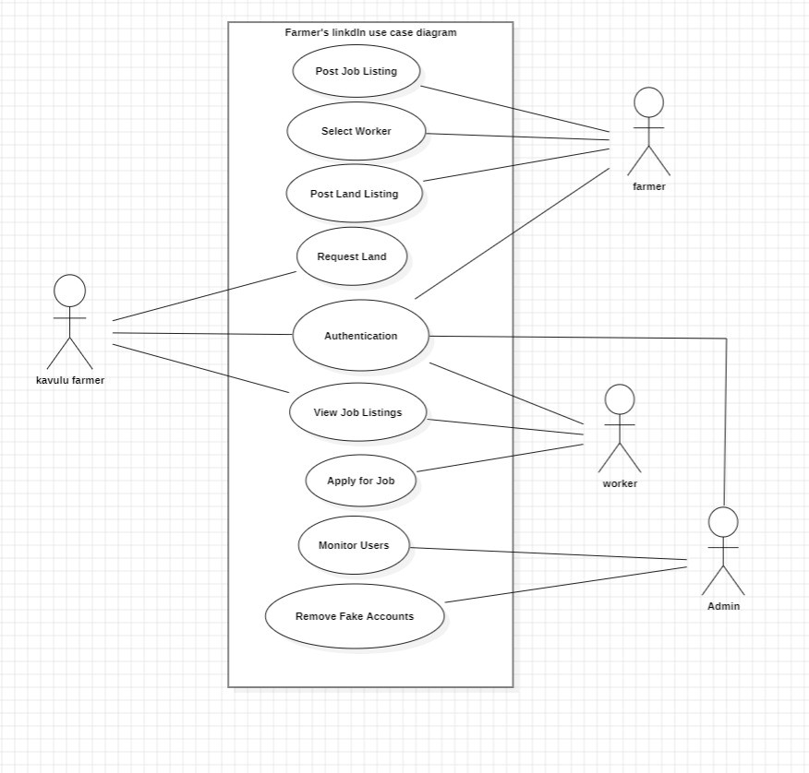
UML Diagrams
Use Case Diagram
Shows who uses the Farmer LinkedIn system (Farmer, Worker, Kavulu-Farmer, Admin) and what actions they can perform such as posting jobs, applying for jobs, requesting land, and managing the platform.

Slide 10
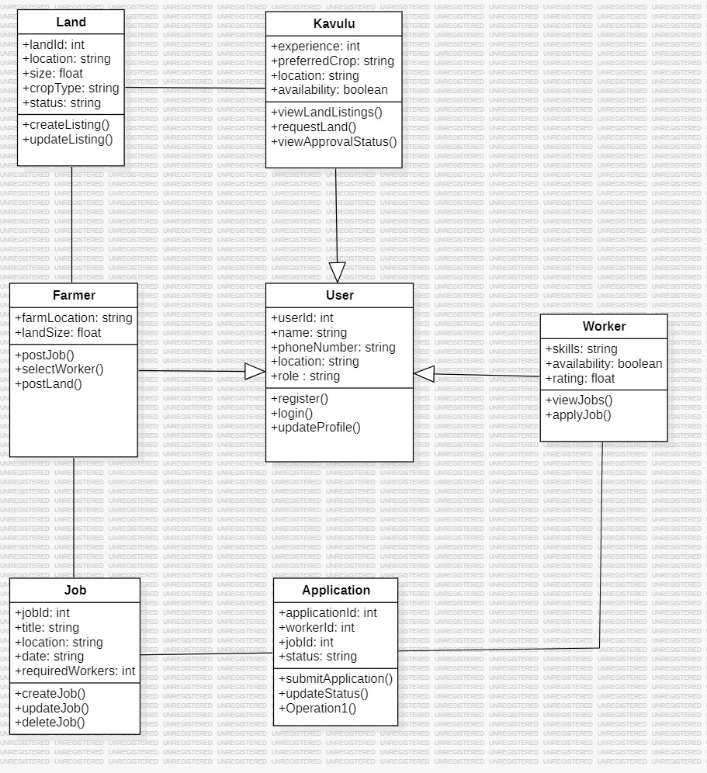
UML Diagrams
Class Diagram
Shows the structure of the Farmer LinkedIn system by representing the main classes (User, Job, Application, LandListing, Notification, Admin) and the relationships between them.
*
*
*
*
*
1
1
1
*
*
*
*
*
*
*

Slide 11
UML Diagrams
Sequence Diagram
Shows the order of interactions between different components (Farmer, Worker, System/Backend, Database) over time to complete a process such as posting a job, applying for a job, and selecting a worker in the Farmer LinkedIn system.

Slide 12
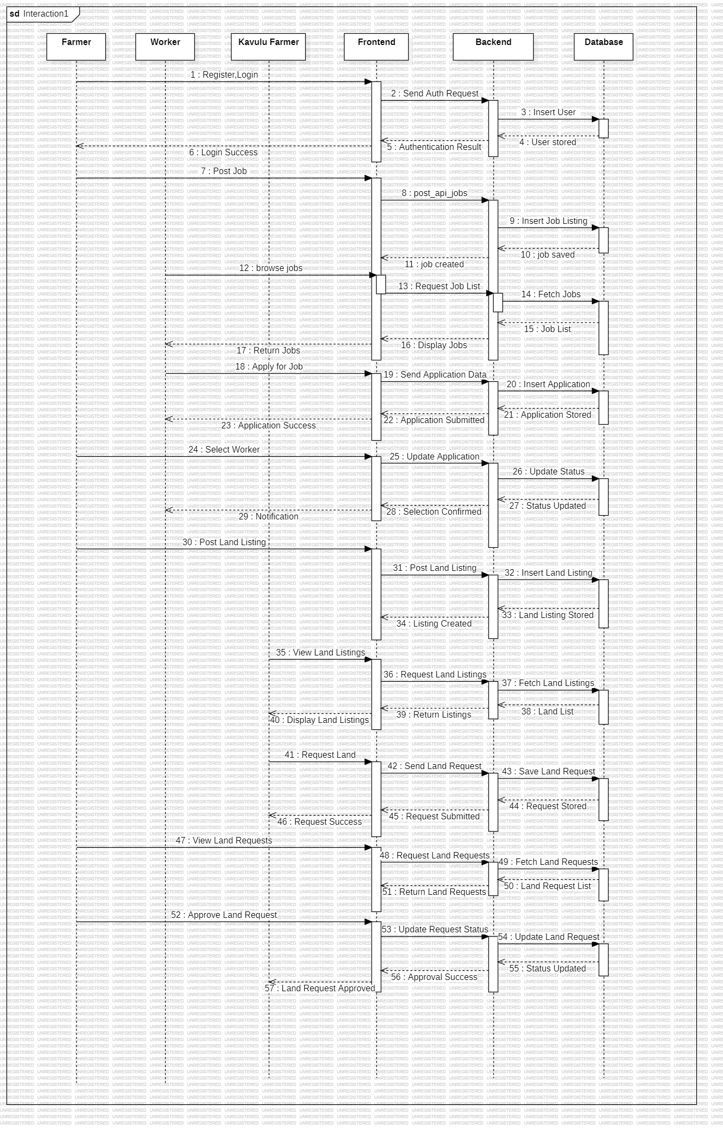

Slide 13
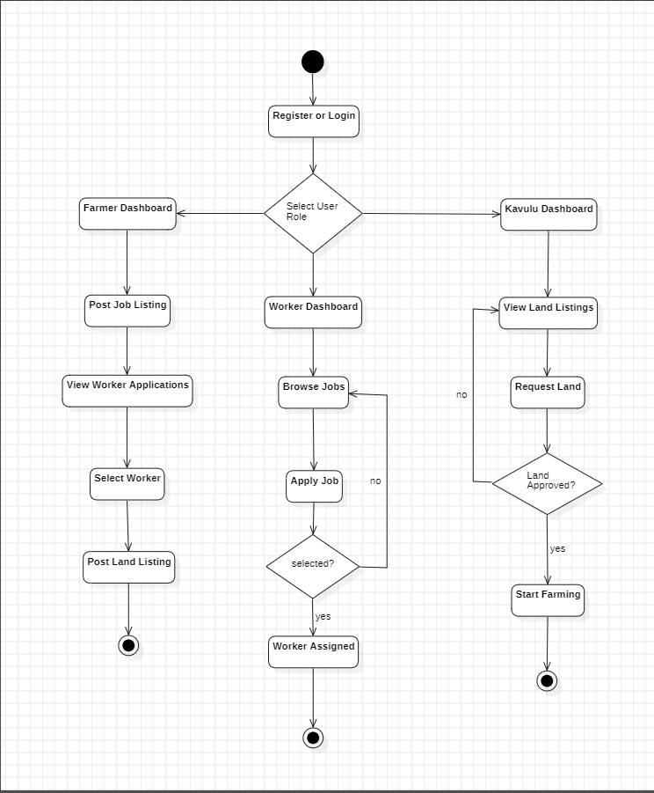
UML Diagrams
Activity Diagram:
Shows the workflow of the AgroConnect system by illustrating the sequence of activities such as user registration, posting jobs, applying for jobs, selecting workers, and requesting land, along with the decision points in the process.

Slide 14
System Specifications
Hardware Requirements
Processor: Intel i5 or equivalent
RAM: Minimum 4 GB (8 GB recommended)
Storage: 256 GB SSD or higher
Internet Connection: Required for cloud deployment
2. Software Requirements
Operating System: Windows
Programming Language: Java
Framework: Spring Boot
Frontend Technologies: HTML, CSS, JavaScript
Database: MySQL
Cloud Platform: AWS (EC2, RDS, S3)
Development Tools: VS Code
Web Browser: Google Chrome
3. Technologies Used
Backend: Spring Boot (Java)
Database Management: MySQL (AWS RDS)
Cloud Hosting: AWS EC2
File Storage: AWS S3
API Communication: REST APIs
Security: JWT Authentication and Role-Based Access Control

Slide 15
MODULES
1. User Authentication Module
2. Job Management Module
3. Land Management Module
4. Admin Management Module

Slide 16
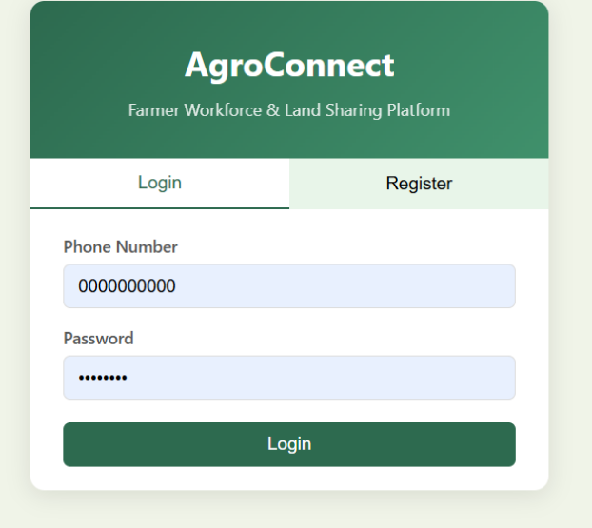
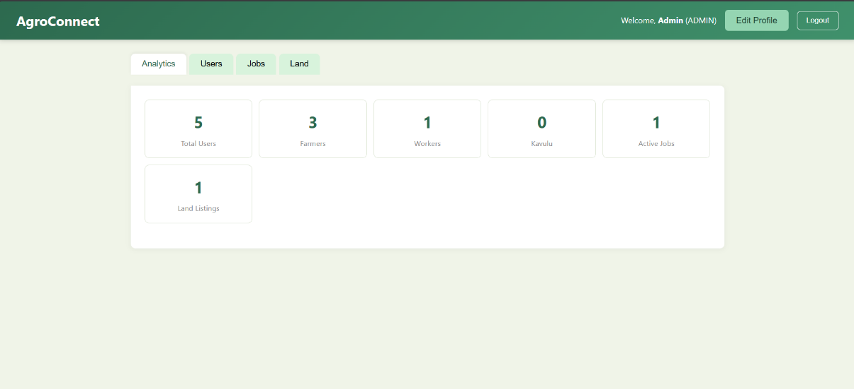
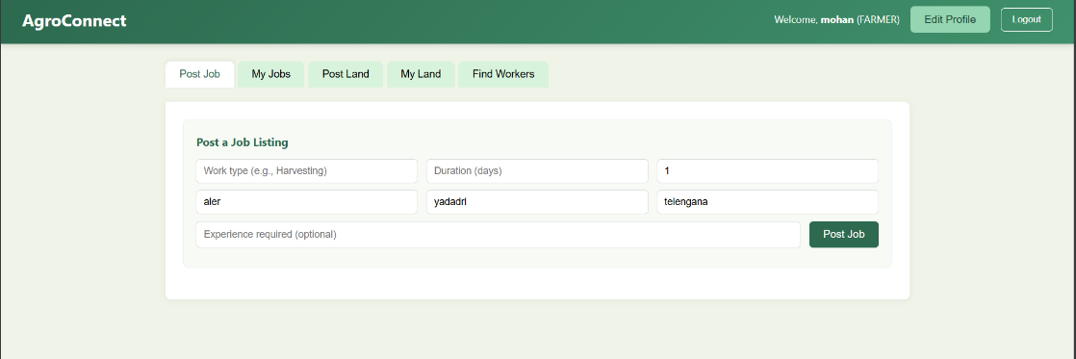
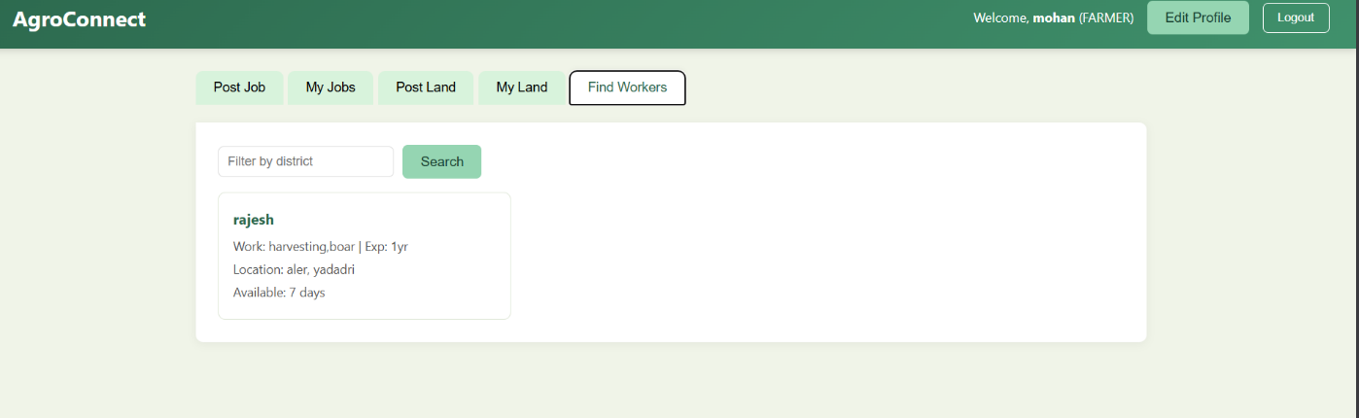
Output Screens

Slide 17
Conclusion
AgroConnect successfully provides a digital platform that connects farmers, workers, and kavulu farmers in a simple and efficient way . The system enables farmers to post job requirements and land availability, while workers and kavulu farmers can easily find and apply for opportunities based on their needs and location . By eliminating communication gaps and improving accessibility, AgroConnect enhances coordination in agricultural activities . The project demonstrates how technology can be used to simplify real-world problems in the farming sector . Futureimprovements can include payment integration, advanced location tracking, and mobile application support.

Slide 18
References
FastAPI Documentation – https://fastapi.tiangolo.com/
Spring Boot Documentation – https://spring.io/projects/spring-boot
MySQL Documentation – https://dev.mysql.com/doc/
UML Official Documentation – https://www.uml.org/
W3Schools (Web Development Reference) – https://www.w3schools.com/
Stack Overflow (Developer Community) – https://stackoverflow.com/
GitHub Documentation – https://docs.github.com/

Slide 19
THANK YOU

